Slide 1
Big Data Architecture and Governance
Individual Project | Allianz
Sayali Bhagat

Slide 2
Overview
Company: Allianz
Industry: Financial services (Insurance & asset management)
History/Background:
Allianz AG was founded in Berlin on 5 February 1890 by the director of the Munich Reinsurance Company Carl von and Wilhelm von. The first Allianz products were marine and accident policies first sold only in Germany, however in 1893 Allianz opened its first international branch office in London. It distributed marine insurance coverage to German clients looking for coverage abroad.
In 1900 the company became the first insurer to obtain a license to distribute corporate policies. In 1904 Paul took over the sole leadership of the company, as it moved into the US and other markets. Markets entered by 1914 included the Netherlands, Italy, Belgium, France, other many countries, and thus Allianz had become the largest marine insurer in Germany. In 1906 the company suffered an early disaster in expansion by earthquake caused in San Francisco. But later the company managed to acquire many other insurance companies and thus expanding over other parts in world.
As of 2014, it is the world's largest insurance company, the largest financial services group and the largest company according to a composite measure by Forbes magazine, as well as the largest financial services company measured by 2013 revenue.

Slide 3
Issue # 1 Name: Personalized Marketing Efforts
AXA and ALLIANZ are the only insurers included in the top 10 growing brands. AXA's brand value went up by 14%, to USD 10,579 million, while ALLIANZ saw a 12% increase of the same indicator, to USD 9,528 million.
According to the study, AXA has better marketing then Allianz and generates a vast amount of credit card information and other transactional data about its customers. Along with publicly available economic statistics from the government, they use new analytic capabilities to develop exclusive insights into consumer trends, and in turn offers those reports to the bank’s clients. The analytic technology has allowed the company to break down the consumer market into smaller segments, even into single individuals, and for reports to be generated in seconds.

Slide 4
Impact Statement for Issue # 1
Analyzing Allianz historical revenue streams and cost structures to identify weaknesses and make improvement on their current services. Further to narrow their understanding of customer segments, and hone in on specific consumers’ needs. Between transaction behavior and social media monitoring, firms can extract a robust picture of customer preferences, lifestyle, and goals. Once these needs are understood, the firm can market certain services and features that are relevant to the consumer’s needs.

Slide 5
Issue # 2 Name: Fraud claim detection
Globally, insurance fraud is a major concern for Insurers which continues to increase year by year. Claims fraud is the most common buzz around the P&C Insurance industry with auto and workers compensation business segments being the major contributors. Frauds are typically an individual or a group led effort of fraudsters with an intention of inflating claims and finally making profit out of a loss. Insurers spend huge effort and manpower in detecting fraud which as a net result not only drain the dollar amount from the insurer’s fund but also adversely affect the good risks that they underwrite. It is also a social risk as it promotes financial crimes and penalizes the society.

Slide 6
Impact Statement for Issue # 2
AXA which has been the long time competitor of Allianz, analyses emails, phone calls, transaction data to detect the possibilities of frauds which would otherwise be difficult to detect. They use Analytics software developed by Palantir to keep a track of employee communications to identify any indications of internal fraud which is way better software than Allianz use.
Allianz can use analytics to differentiate fraudulent interactions from legitimate business transactions. By applying analytics and machine learning, they are able to define normal activity based on a customer’s history and distinguish it from unusual behavior indicating fraud. The analysis systems suggest immediate actions, such as blocking irregular transactions, which stops fraud before it occurs and improves profitability.

Slide 7
Company SWOT Analysis

Slide 8
SWOT Analysis
Strength | Weakness
Leading in Global Asset Management Automation of activities brought consistency of quality Good Returns on Capital Expenditure Highly skilled workforce through successful training and learning programs Low cost structure helps it produce & sell at low price to customers | Lack of proper financial planning related to cash flows Not conducted market research since past 2 years Lower budget for its quality control department than competitors High employee turnover rates Spending way less than a few players within the industry in research & development
Opportunity | Threats
Carefully investing and pairing with other companies to diversify its market Digitization as an investment option Increase in the number of social media users worldwide can be used to promote products, interact with customers & collect feedback Green government drive: Opportunity to sale products to federal and state government contractors | No regular supply of innovative products Increasing competition & new entrants Fraudulent activities Changing regulations on international trade Exchange rate keeps fluctuating and this affects tremendously

Slide 9
Project Mandate

Slide 10
Project Name: Personalized Marketing Efforts
1. AUTHORITY RESPONSIBLE
Sales Director, Marketing Director
2. BACKGROUND
The project will primarily focus working on analysis of customer data and making Market analysis to identify emerging trends in products and services. It will be a stand alone project to fulfill the innovated product supply requirement but later might be working with Fraud claim detection project to increase the security of the customers and its services.
3. PROJECT OBJECTIVES
In this project Personalized marketing, targeting customers on the basis of their individual spends and analysis of the customer behavior on social media through sentiment analysis will be done to create credit risk assessment and offer customized products to the customer.
4. SCOPE
Acquisition of getting new customers, by targeting prospects through campaigns, re-engaging existing & previous customers or dormant customers to buy new products/services, Relationship management (Cultivating the customer’s relationship with the company)

Slide 11
Project Name: Personalized Marketing Efforts
5. CONSTRAINTS
Current technologies are not able to handle the high-volume, high-velocity, high-variety data sets and analyze these data sets in a timely manner. Thus will have to invest in new technologies to support the project. Company will have to start investing heavily in resources like Data scientist & Engineers.
6. INTERFACES
The data source required to support the project will be purchase history, prior years survey, email activity, website behavioral data & mobile actions
7. QUALITY EXPECTATIONS
Allianz has not conducted market research within the market that is serves since the past 2 years. As a result, it is making decisions based on 2 years old data, while customer needs may have evolved over time. Thus with this project the firm can market certain services and features that are relevant to the consumer’s needs
8. OUTLINE BUSINESS CASE
The project will follow 5 P’s strategy for completing the project – Product, Price, Placement, Promotion and People. The target audience over here is our customers and we’re finding new emerging trends as per the customer’s needs
9. CUSTOMERS AND USERS
Private individuals, families, organizations and partners

Slide 12
Vision Diagram

Slide 13
Project Name: Fraud claim detection
PURPOSE
This document contains the information that is used to trigger the Starting up a Project Process. It will also identify the prospective Business Executive and Project Sponsor/s
1. AUTHORITY RESPONSIBLE
Security & Risk Management Director, Security & Compliance Director
2. BACKGROUND
The project will primarily focus on fraud claims and ways to stop them. It will be a stand alone project to fulfill the need of security of Customers.
3. PROJECT OBJECTIVES
Detect financial crime such as fraud, money laundering, or counter-terrorism financing activities by identifying transaction anomalies or suspicious activities using transactional, customer, black-list, and geospatial data.
4. SCOPE
Release new UBI (User Based Insurance) products that are not only based on users’ basic personal information, but also user activity, market environment, and market trend analysis. Also, built a analysis systems to suggest immediate actions, such as blocking irregular transactions, which stops fraud before it occurs and improves profitability.

Slide 14
Project Name: Fraud claim detection
5. CONSTRAINTS
Restrictions of regulatory requirements and privacy concerns. Reliability and security of the firm on it’s resources with the data.
6. INTERFACES
The data source required to support the project will be siloed data. transactional data & patterns, IP addresses
7. QUALITY EXPECTATIONS
Fraud Claims don’t just affect the company financially but also affects the Customer relationship. Customer security is one of the major factor for the Quality Expectations which we’re trying to protect and improve.
8. OUTLINE BUSINESS CASE
A realistic, robust business case should consider a broad array of components like, loss reduction, fraud management operating costs, Fraud loss avoidance, Fraud management costs, Compliance and legal costs and Customer impact.
9. CUSTOMERS AND USERS
Fraud, Risk and Finance Analyst

Slide 15
Vision Diagram

Slide 16
Project Resource & Budget

Slide 17
Project Budget Breakdown
 | Item | Cost | Notes
Hardware | Servers | $410,500 | 18 @ $22.8k each; enterprise class with dual power supplies, 48TB of serial-attached SCSI (SAS) storage, 48- 64 gigabytes memory, 1 rack
 | Hardware support | $67,600 | @15% of list cost
 | Installation | $14,000 | Licenses and dedicated hardware
 | Networking | $40,000 | 3 @ estimated $6k for InfiniBand, 1 @ $11k for admin switch, 18 @ $0.6k for cables, looms, patch panels, etc.
Software | licensing | $388,800 | Cloudera: 18 nodes @ estimated $7.2k each per year
 | Database & other software | $134,000
Consulting |  | $40,000 | McKinsey, Deloitte, Other Agency
Operation | Labor and other Costs | $697 600 | Maintenance costs Employee health insurance, pensions, and other benefits Labor cost such as payroll
Other |  | $54,000 | Office space and other rental
Total |  | $1,846,500

Slide 18
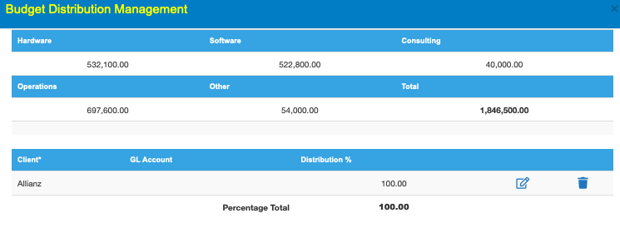
Project Name: Personalized Marketing Efforts
Project Budget

Slide 19
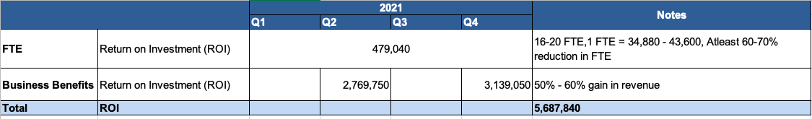
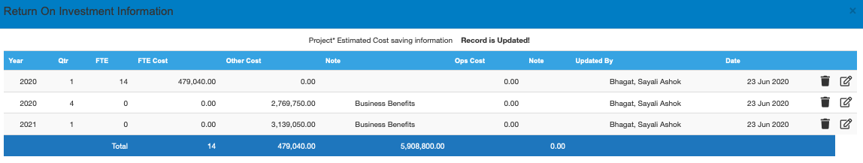
Project Name: Personalized Marketing Efforts
ROI – Determine 3/5 years cost of ownership

Slide 20
Project Name: Personalized Marketing Efforts
Resource Planning:
Phase | Developer engineers/ software engineers | Database analysts/ DBA | Data analysts | Big data PM | Sys Admin
Architecture design |  | 3% |  | 2% | 5%
Hardware and software configuration |  | 2% |  | 2% | 5%
System development and integration | 20% | 2% | 10% | 10%
Testing and launch | 10% | 1% | 3% | 3%
Maintenance | 10% | 2% | 2% | 3% | 5%
Total | 40% | 10% | 15% | 20% | 15%

Slide 21
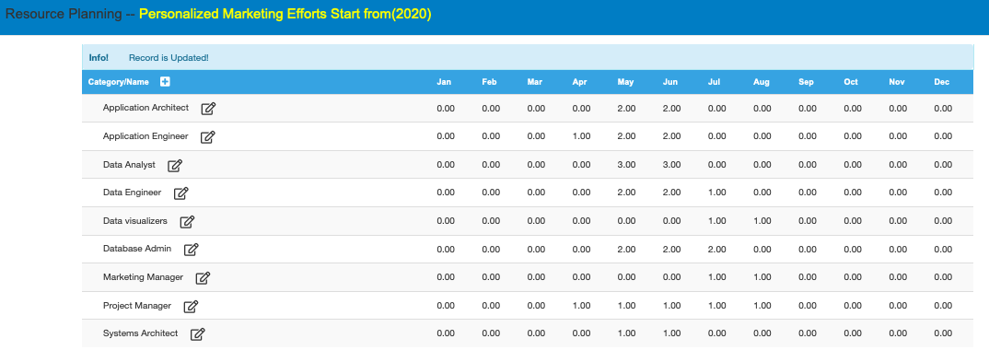
Project Name: Personalized Marketing Efforts
Required Resources

Slide 22
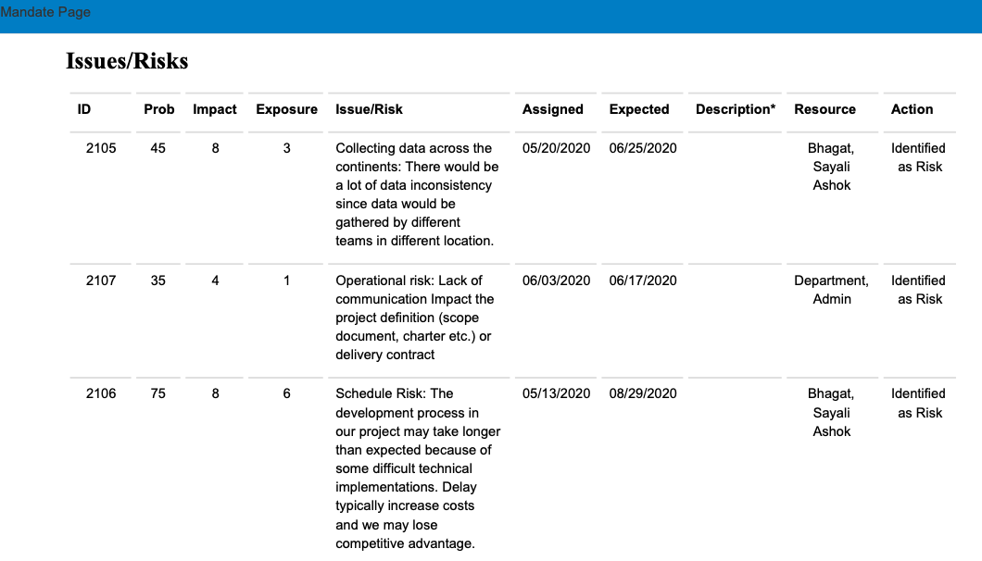
Project Name: Personalized Marketing Efforts
Issues and Risks

Slide 23
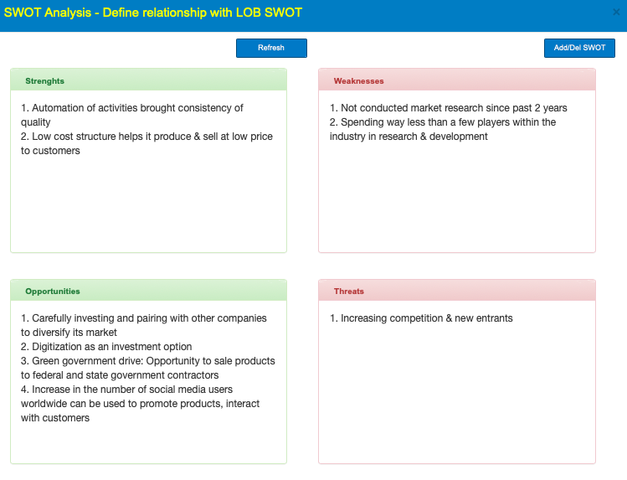
Project Name: Personalized Marketing Efforts
Relationship between your company SWOT and Project

Slide 24
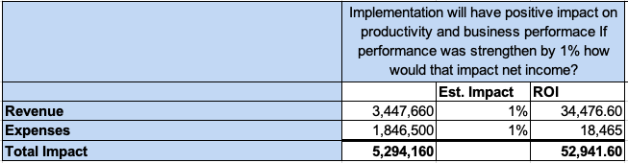
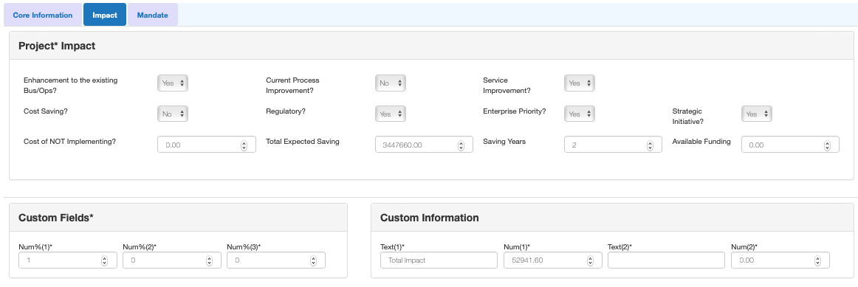
Project Name: Personalized Marketing Efforts
Impact:

Slide 25
Project Name: Fraud claim detection
Project Budget

Slide 26
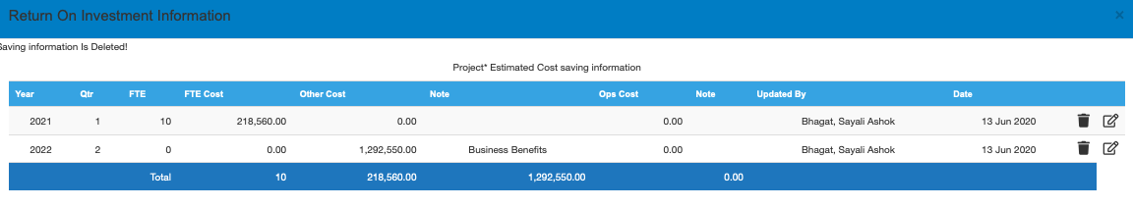
Project Name: Fraud claim detection
ROI – Determine 3/5 years cost of ownership

Slide 27
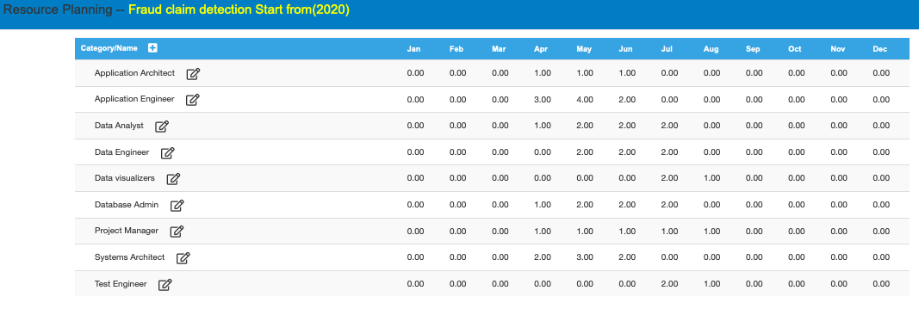
Project Name: Fraud claim detection
Required Resources

Slide 28
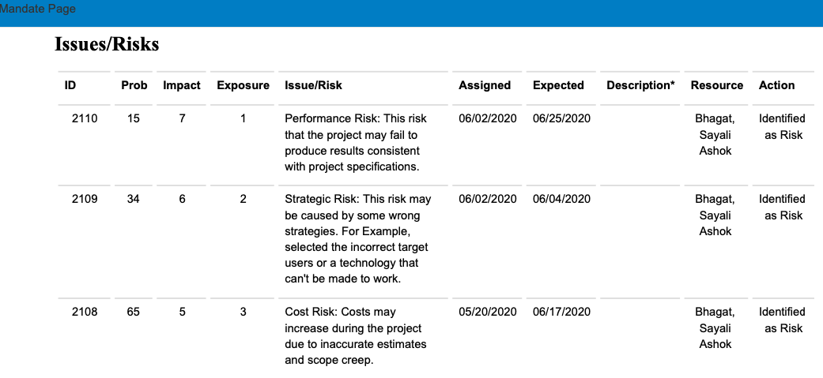
Project Name: Fraud claim detection
Issues and Risks

Slide 29
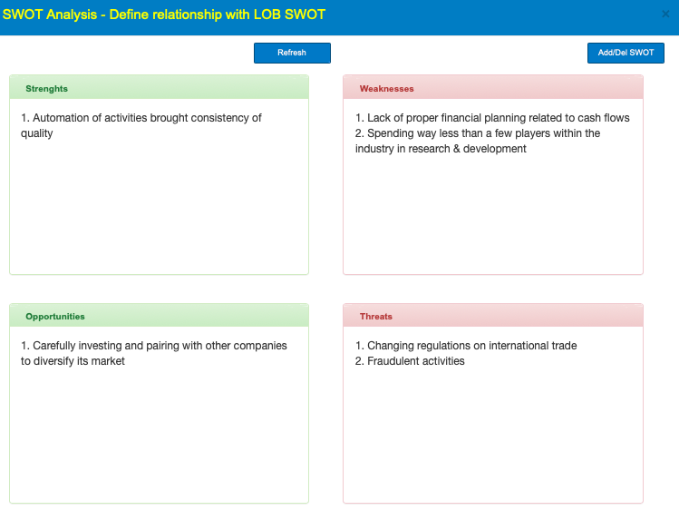
Project Name: Fraud claim detection
Relationship between your company SWOT and Project

Slide 30
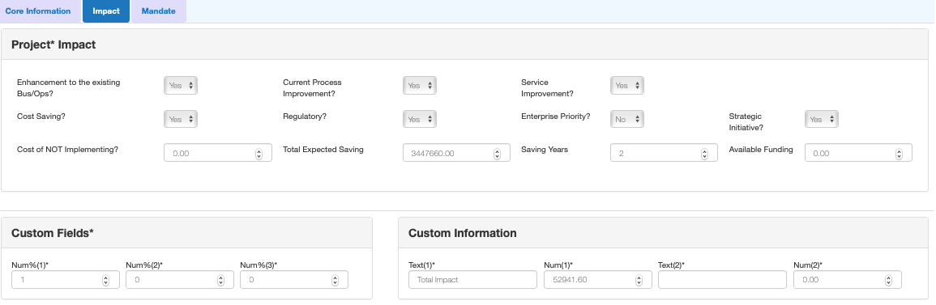
Project Name: Fraud claim detection
Impact:

Slide 31
Selection Logic

Slide 32
Comparison
Factors | Personalized Marketing Efforts | Fraud Claim Detection
Budget | Less cost is required to implement | More cost is required for implementation
Products/ Features | Multiple new and innovated products | Only security features
Time | Less time for completion | More time for completion
Risk & Issues | If customers are not satisfied with new products it will be a great loss for company. | Since the target is to primarily focus on fraud claims and ways to stop them the risk on implementing would be less
Strength | Brand Name, More new Products | Security & Customer Satisfaction
Weakness | Data collected across continents should be accurate | Need to reformulate the existing security measures which would be time consuming
Business Benefits | Maximizing customer lifetime value & Reducing customer acquisition costs | Improving customer engagement
ROI | The ROI would be great once the products are able to generate revenue from multiple source | ROI would be less since it has only one target

Slide 33
Selection : Personalized Marketing Efforts
Reasons
Larger scope in ROI and more profitable
It just not replaces the old products but also improves the process work flow starting from collecting the data to delivering multiple products & features
More skilled employees would be added in the team
Will increase the number of Stakeholders & Customers
Also, we can implement some advance security features in new products using new technologies

Slide 34
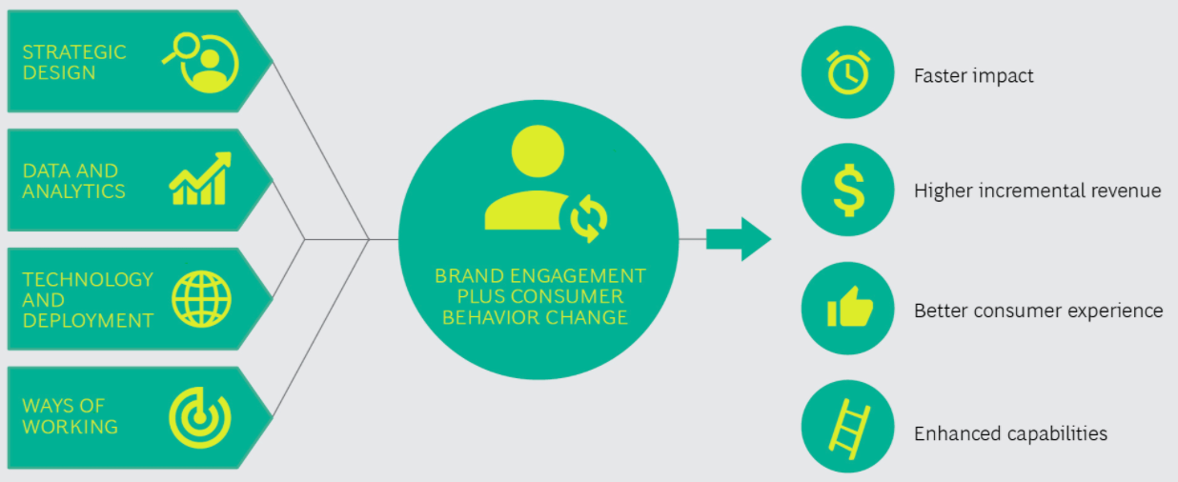
Selection : Personalized Marketing Efforts
Strategy Approach & Business Benefits:

Slide 35
Thank you!

